Slide 1
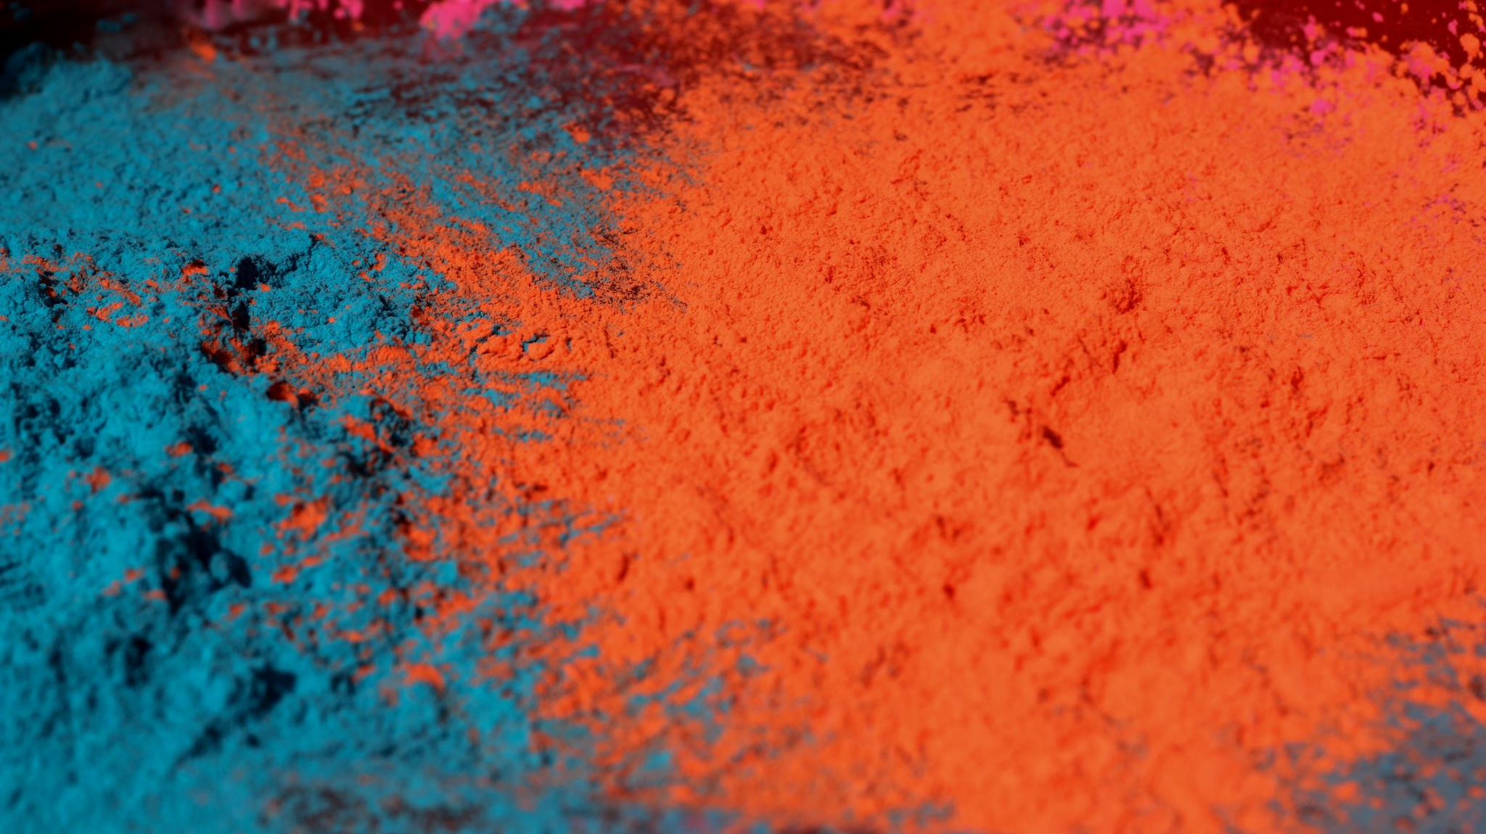
Life Span & Development Final Project
Shania Evans

Slide 2
5 Topics
Breast Milk VS. Formula
Retirement causes people to die faster
Infant fear triggers abnormal behavior (chapter 4)
Some gender differences are biologically based (6)
All kids need to be spanked

Slide 3
Breast Milk Vs. Formula
Breast Milk Pros
Digest easily (Lönnerdal, 2017).
It is free
Nurtures stronger bond- Though not it is not easy, the bond the mother feels with her baby is completely worth it.
Breast Milk Cons
The mother is always got to be there
Medications can interfere
Uncomfortable experience
Not all babies are able to breastfeed easily

Slide 4
Formula?
Pros
The baby can be fed by anyone.
It is less stressful
Great bonding is still possible (Condurso et al. 2020).
The baby feeds less often since formula takes considerable time to digest
Cons
Additional cost
It must be prepared; wrongful preparation results in changes in nutrient levels.
Allergies

Slide 5
Why breast milk
Having a healthy infanthood is key to growing healthy thus as parents rush to immunize their children against diseases, giving them nutrient food is essential.
Compared to formula-fed infants, breastfed infants have fewer infections and hospitalization.
Through breast feeding, a baby’s immune system is strengthen
A strengthen immune system lowers the chances of a baby getting infections including ear infections (Lönnerdal, 2017).
The ease of digestion of breast milk helps protect the baby’s tender digestive system.

Slide 6
Retirement causes people to die faster
A study carried on Shell oil workers found that workers who retire at the age of 55 are 89% more likely to die during the 10 years after retirement than workers who retire at 65 (Hagen, 2018).
Inasmuch as there is disparity in the number of ages that people retire, what is constant is that they all get to die faster after retirement.
The societal rumors that many of them die as a result of loneliness made believe that it was true courtesy of studies that have been carried out.
The studies indicate that many of the retirees are usually in good health and possess a lower of dying from all causes but still end up dying.
As such, there is something more than loneliness that leads to their untimely death.

Slide 7
What Causes Retirees to Die Faster
Sedentary lifestyle: Some retirees are so beet from years of hard work that they take relaxing to an extreme. Instead of exercising, they stay at home and watch their favorite shows., reading or knitting. These activities deny the heart and mind that were used to good workout their normal dose and within no time, they will start failing leading to precarious consequences.
Depression: It usually forms a better part of their life after retiring and since they do want to seek help, the untreated depression could lead to an untimely death due to suicide
Worry: Even though everyone knows that one day he or she will die, retiring always makes to think that his time on earth is over and thus the only thing remaining is death. The worry usually make one increasingly anxious and thus putting burden on the immune system making one prone to all kinds of illnesses.

Slide 8
Infant fear triggers abnormal behavior
Infants are always terrified of two fears: loud noises and falling (LoBue et al., 2019).
Inasmuch as the brains and nerves grow rapidly in the first two years of life, infants are always born with very immature nervous systems. Therefore they cannot interpret or handle certain sensory input. Thus why it is difficult for a baby to react when being passed around to loving relatives.
Setting him down too fast or make an abrupt , loud noise usually results in the kid crying in fright or rather an abnormal behavior.
Research on this topic has made to know why infants are usually not choosy when being carried by their relatives but within a considerable time, they start being choosy.
The abnormal behavior is triggered by the brain and nerves.

Slide 9
Some gender differences are biologically based
I have always known that gender is biological and the only difference that everyone knows is one is either a male or a female.
This research made me realize that gender is psychological, social or cultural and that sex is what is biological.
With regard to sex, I had always known that the only and obvious way of knowing whether one is male or female is the internal genitalia such as uterus in females and external genitalia such as penis in males.
The other three determinants of sex; the presence or absence of a Y chromosome, the gonad type, the sex hormones.

Slide 10
Why are some gender difference are biologically based
In the society there are certain ways by which a man and female is supposed to behave.
There are those that go against these norms and somehow behave like a female yet he is man, or a female behaving like a man.
Inasmuch as their sexes cannot be changed, their psychology always changes and begin to see themselves as the opposite sex (Hyde et al., 2019).
This is always attributed to the fact almost all the sex determinants except the internal and external genitalia point at one being a male in a female’s body or vice versa.
As such, this show that some gender difference are biologically based.

Slide 11
All Kids need to be Spanked
Spanking of children is a topic that has been widely debated by parents and experts on whether it is effective or not.
To many spanking a child is like corporal punishment that should never be entertained. Others believe that spanking is the effective way of disciplining a child when he or she does something wrong.
Inasmuch as spanking may be seen as the effective way in a parent’s tool chest as they seek to steer their children away from negative behavior and guides them towards becoming responsible members of the society, it has an unprecedented repercussions.
Spanking a kid usually results in the kid fearing the parent and this may ultimately affect their relationship
Personally I belong to the camp that advocates for other forms of disciplinary measures rather than spanking a kid.

Slide 12
Why kids should not be spanked
It models aggression- Children do what parents do more that what they say.
It create shame-If one is struck by a parent, he or she might think he is bad, and struggle with self –esteem, trust and mental health issues.
It shifts focus to the parent’s behavior
Does not work for older kids
It is less effective over time
It does not teach appropriate behavior

Slide 13
References
Condurso, C., Cincotta, F., Merlino, M., Stanton, C., and Verzera, A. (2020). Stability of powdered infant formula during secondary shelf-life and domestic practices. International Dairy Journal, 109, 104761.
Hagen, J. (2018). The effects of increasing the normal retirement age on health care utilization and mortality. Journal of Population Economics, 31(1), 193-234. LoBue, V., Kim, E., & Delgado, M. (2019). Fear in development. In Handbook of emotional development (pp. 257-282). Springer, Cham.
Hyde, J. S., Bigler, R. S., Joel, D., Tate, C. C., and van Anders, S. M. (2019). The future of sex and gender in psychology: Five challenges to the gender binary. American Psychologist, 74(2), 171.
Lönnerdal, B. (2017). Bioactive proteins in human milk—potential benefits for preterm infants. Clinics in perinatology, 44(1), 179-191.

